Slide 1
Programming Fundamentals
By
Shazmeen Batool

Slide 2
Previous Lecture
Basics of Arrays
Declaring Arrays
Initializing Arrays
Accessing Arrays
Processing Arrays

Slide 3
Today’s Lecture
Class Activities
No Bounds Checking in C++
Watch for Off-by-One Errors
The Range-Based for Loop
auto Keyword
The Range-Based for Loop versus the Regular for Loop

Slide 4
Class Activity 1
Define the following arrays:
ages, a 10-element array of ints initialized with the values 5, 7, 9, 14, 15, 17, 18, 19, 21, and 23.
temps, a 7-element array of floats initialized with the values 14.7, 16.3, 18.43, 21.09, 17.9, 18.76, and 26.7.

Slide 5
Class Activity 1
Define the following arrays:
alpha, an 8-element array of chars initialized with the values ‘J’, ‘B’, ‘L’, ‘A’, ‘*’, ‘$’, ‘H’, and ‘M’.

Slide 6
Class Activity 2
Is each of the following a valid or invalid array definition? (If a definition is invalid, explain why.)
int numbers[10] = {0, 0, 1, 0, 0, 1, 0, 0, 1, 1};
Valid.
int matrix[5] = {1, 2, 3, 4, 5, 6, 7};
Invalid.
The initializer list has 7 values, but the array size is 5. This will cause a compilation error because too many initializers for the specified size.
double radii[10] = {3.2, 4.7};
Valid.

Slide 7
Class Activity 2
Is each of the following a valid or invalid array definition? (If a definition is invalid, explain why.)
int table[7] = {2, , , 27, , 45, 39};
Invalid.
Syntax errors: extra commas without values are not allowed in initializer lists in C++. Each element must be initialized explicitly or omitted (to default to zero). The correct way would be to omit the extra commas or assign values accordingly.
char codes[] = {'A', 'X', '1', '2', 's'};
Valid.

Slide 8
Class Activity 2
Is each of the following a valid or invalid array definition? (If a definition is invalid, explain why.)
int blanks[];
Invalid.
You cannot declare an array without specifying its size or providing an initializer. This will cause a compilation error.

Slide 9
Class Activity 3
Given the following array definition:
int values[] = {2, 6, 10, 14};
What does each of the following display?
cout << values[2];
Output: 10
cout << ++values[0];
Output: 3
Now, the array is: {3, 6, 10, 14}

Slide 10
Class Activity 3
Given the following array definition:
int values[] = {2, 6, 10, 14};
What does each of the following display?
cout << values[1]++;
After this statement, values[1] becomes 7.
Now, the array is: {3, 7, 10, 14}.

Slide 11
Class Activity 3
Given the following array definition:
int values[] = {2, 6, 10, 14};
What does each of the following display?
x = 2;
cout << values[++x];
x is assigned 2.
++x increments x before using it, so x becomes 3.
values[3] is 14.
Output: 14

Slide 12
No Bounds Checking in C++
C++ does not prevent you from overwriting an array’s bounds.
To increase runtime efficiency, C++ does not provide many of the common safeguards to prevent unsafe memory access found in other languages.
For example, C++ does not perform array bounds checking. This means you can write programs with subscripts that go beyond the boundaries of a particular array.

Slide 13
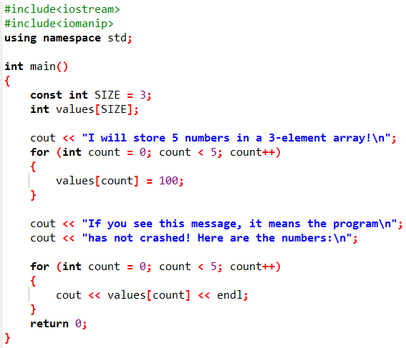
Think twice before you compile and run this Program.
The program will attempt to write to an area of memory outside the array. This is an invalid operation and will most likely cause the program to crash.

Slide 14
No Bounds Checking in C++
Program in the previous slide might run without an error on many systems/compilers (like GCC or Visual Studio), but it's not guaranteed—and it's a bad idea. Here's why:
No Compile-Time Error: The code will compile fine because C++ doesn't check array bounds at compile time. The array values[SIZE] (with SIZE = 3) is declared, and the loops use variables, so the compiler sees valid syntax.

Slide 15
No Bounds Checking in C++
Runtime Behavior: At runtime, writing to values[3] and values[4] (beyond the array's 3 elements) is undefined behavior. This means:
It could "work" and print something like 100 five times (if the extra writes land in unused memory).
It could crash (e.g., segmentation fault on Linux/Mac).
It could corrupt other data in your program, leading to weird bugs or security risks.
Results vary by compiler, OS, and luck—don't rely on it!

Slide 16
No Bounds Checking in C++
Although C++ programs are fast and efficient, the absence of safeguards such as array bounds checking usually proves to be a bad thing. It’s easy for C++ programmers to make careless mistakes that allow programs to access areas of memory that are supposed to be off-limits. You must always make sure that any time you assign values to array elements, the values are written within the array’s boundaries.

Slide 17
Watch for Off-by-One Errors
In working with arrays, a common type of mistake is the off-by-one error. This is an easy mistake to make because array subscripts start at 0 rather than 1.
It happens when you accidentally point to the wrong spot in the array—often by one position too early or too late.
This is easy to do because arrays start counting from 0, not 1. For example, if you have 5 items, valid spots are 0, 1, 2, 3, 4. If you loop from 1 to 5, you skip the first item (0) or go past the end (5 is invalid).
Why it matters: It can make your program print wrong data, crash, or access bad memory.

Slide 18
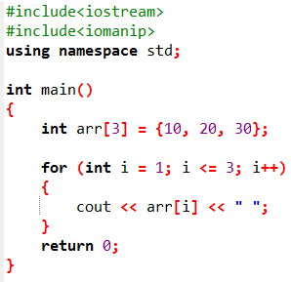

Example

Slide 19
The Range-Based for Loop

Slide 20
The Range-Based for Loop
The range-based for loop is a loop that iterates once for each element in an array. Each time the loop iterates, it copies an element from the array to a variable. The range-based for loop was introduced in C++ 11.
When you use the range-based for loop with an array, the loop automatically iterates once for each element in the array.

Slide 21
The Range-Based for Loop
For example, if you use the range-based for loop with an eight-element array, the loop will iterate eight times.
Because the range-based for loop automatically knows the number of elements in an array, you do not have to use a counter variable to control its iterations, as with a regular for loop.
Additionally, you do not have to worry about stepping outside the bounds of an array when you use the range-based for loop.

Slide 22
The Range-Based for Loop
The range-based for loop is designed to work with a built-in variable known as the range variable. Each time the range-based for loop iterates, it copies an array element to the range variable.
For example, the first time the loop iterates, the range variable will contain the value of element 0, the second time the loop iterates, the range variable will contain the value of element 1, and so forth.

Slide 23

The Range-Based for Loop
Here is the general format of the range-based for loop:
Let’s look at the syntax more closely as follows:
dataType is the data type of the range variable. It must be the same as the data type of the array elements, or a type that the elements can automatically be converted to.

Slide 24
The Range-Based for Loop
rangeVariable is the name of the range variable. This variable will receive the value of a different array element during each loop iteration. During the first loop iteration, it receives the value of the first element; during the second iteration, it receives the value of the second element, and so forth.
array is the name of an array on which you wish the loop to operate. The loop will iterate once for every element in the array.

Slide 25
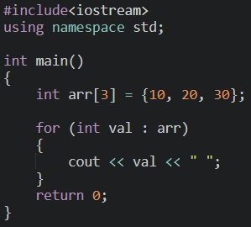
The Range-Based for Loop
statement is a statement that executes during a loop iteration. If you need to execute more than one statement in the loop, enclose the statements in a set of braces.

Slide 26
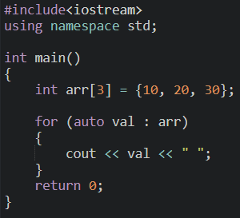
The Range-Based for Loop
If you wish, you can use the auto key word to specify the range variable’s data type.

Slide 27
auto Keyword
The auto keyword in C++ is a way to let the compiler automatically figure out the type of a variable for you.
Instead of writing the full type (like int), you just write auto, and the compiler guesses it based on what you assign to the variable.
Example
Without auto: int number = 42; (You specify int.)
With auto: auto number = 42; (The compiler knows it's an int because 42 is an integer.)

Slide 28
auto Keyword
Introduced in C++11 to reduce typing and avoid mistakes.
It only works when you initialize the variable right away (e.g., auto x = something;).
The type is deduced at compile time, so it doesn't slow down your program.
Use it for local variables, loops (like for (auto item : list)), or when the type is obvious.
Avoid it if you need to be explicit about the type for clarity or safety.

Slide 29
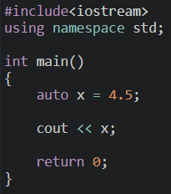

auto Keyword

Slide 30
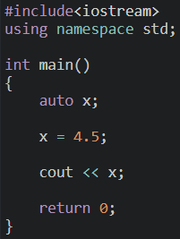

auto Keyword

Slide 31
The Range-Based for Loop versus the Regular for Loop

Slide 32
The Range-Based for Loop versus the Regular for Loop
The range-based for loop can be used in any situation where you need to step through the elements of an array, and you do not need to use the element subscripts.
It will not work, however, in situations where you need the element subscript for some purpose. In those situations, you need to use the regular for loop.

